Slide 1
Internet Applications
Hypertext Transfer Protocol (HTTP)

Slide 2
Network Application Architectures
Two main system architectures
Client-server model
Peer-to-peer model
Both live on the Edge
These are ways of organizing how applications talk to each other
All communication still routed through the same network layers we discussed last class

Slide 3
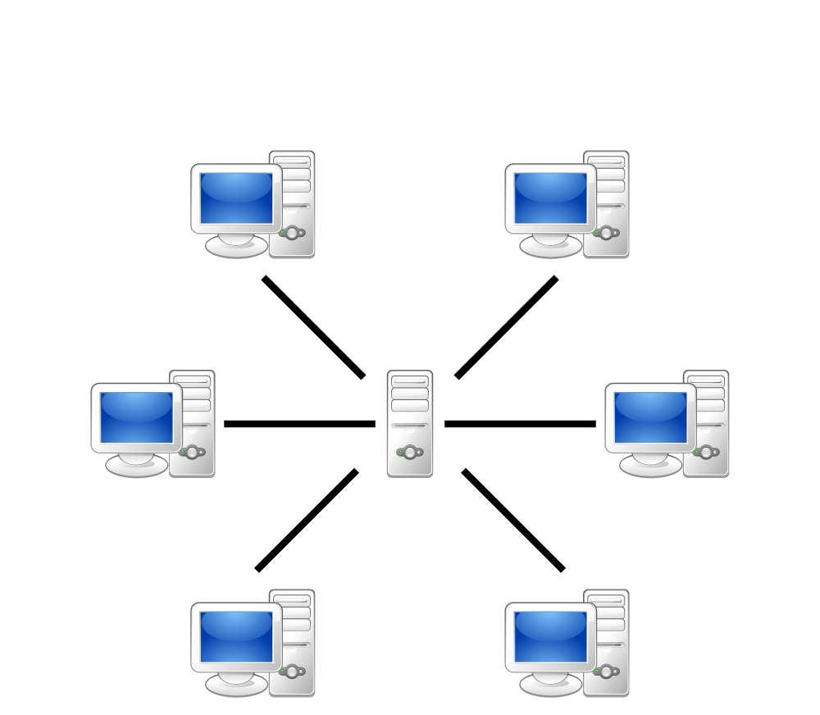
Client-Server Model
Clients request information from the server, server provides information to the clients
Clients don’t talk to each other
Very distinct roles (generally)
Clients don’t contribute to servers
Servers don’t initiate with clients

Slide 4

Servers
Must be always on or the application won’t work
Need a fixed IP address so clients can contact them
Bigger applications need better servers
Often need giant clusters of servers to handle all the clients
Also needs high throughput links to handle large amounts of traffic
But, can be run on anything if there aren’t many clients

Slide 5
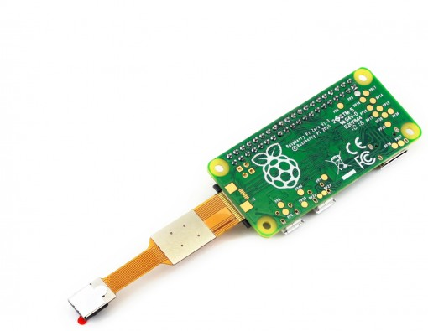
Clients
Only on when a user needs them
IP address doesn’t matter, because server doesn’t initiate contact with them
Rarely needs to be as powerful as a server

Slide 6
Client-Server Communication
Follows the request-response messaging pattern
Client submits request in agreed upon format
Server processes request and returns data in agreed upon format
The internals of both the client and server are hidden from each other (like network layers)

Slide 7
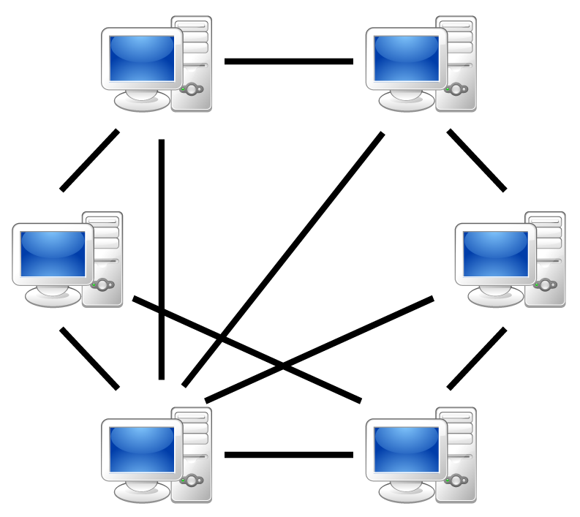
Peer-to-Peer (P2P) Model
No central server (or very little reliance on a central server)
Focuses on communication between peers (users/clients)
Examples include BitTorrent, Bitcoin, Skype

Slide 8
Peer-to-Peer (P2P) Model
Benefits
Self-scalable: as more users come online, computing power automatically increases
Cost-effective: no need for centralized servers, bandwidth
Potential problems
Security, privacy becomes more complicated
Often requires much more complicated models
Potential issues with performance and reliability
E.g. Skype collapsed twice due to problems

Slide 9
The Web and HTTP
The World Wide Web is one of many applications that run on the internet
Serves Web pages, and related content (images, etc)
The Web’s application protocol is HTTP
Web browsers (clients) exchange HTTP messages with servers to receive Web pages and related content

Slide 10
Anatomy of a Web Page
Web pages can consist of many objects/files
HTML files define page layout, static content
Image files can be linked to by HTML files
CSS files define styling information
Video clips, Java applets, …
All files are referenced using URLs
http://www.clemson.edu/computing/exciting_image.gif
A base HTML file includes references to all other files needed for that page

Slide 11
Anatomy of a Web Page
Web pages can consist of many objects/files
HTML files define page layout, static content
Image files can be linked to by HTML files
CSS files define styling information
Video clips, Java applets, …
All files are referenced using URLs
http://www.clemson.edu/computing/exciting_image.gif
A base HTML file includes references to all other files needed for that page

Slide 12
Anatomy of a Web Page
Web pages can consist of many objects/files
HTML files define page layout, static content
Image files can be linked to by HTML files
CSS files define styling information
Video clips, Java applets, …
All files are referenced using URLs
http://www.clemson.edu/computing/exciting_image.gif
A base HTML file includes references to all other files needed for that page

Slide 13


HTTP Protocol
HTTP defines how clients (e.g. browsers) communicate with servers in order to request content
Communicates over TCP sockets
HTTP Request
2. HTTP Response

Slide 14
HTTP Protocol
General process
Client initiates TCP connect to server, using port 80
Server accepts TCP connection from client
Exchange HTTP messages between client and server
Close TCP connection
HTTP is stateless
Server maintains no state about past client requests
Stateful protocols are complex, resource intensive

Slide 15
HTTP Request Message
Two types of HTTP messages: request, response
Example HTTP Request message
GET /index.html HTTP/1.1\r\n
Host: www-net.cs.umass.edu\r\n
User-Agent: Firefox/3.6.10\r\n
Accept: text/html,application/xhtml+xml\r\n
Accept-Language: en-us,en;q=0.5\r\n
Accept-Encoding: gzip,deflate\r\n
Accept-Charset: ISO-8859-1,utf-8;q=0.7\r\n
Keep-Alive: 115\r\n
Connection: keep-alive\r\n
\r\n
Request line
Header lines
End of header

Slide 16
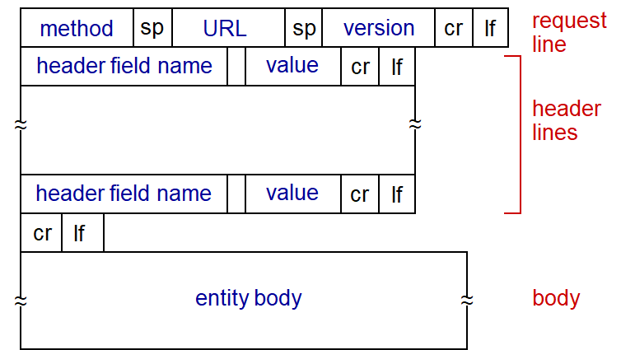

Slide 17
Method Types
GET: most commonly used, requests content, no entity body
POST: requests content & sends content in entity body, commonly used with online forms
GET can also send content by adding it to the request URL
HEAD: like GET, but only wants the header. For debugging
PUT: Upload a file to a specific location on the server, included in entity body
DELETE: Delete files on the server specified by the URL

Slide 18
HTTP Request Header
Many different parameters possible in the header, optional
Common headers include
Host: address of the server
User-Agent: the web browser that generated the request
Accept: Media types accepted by client
Accept-Language: Languages accepted by client
Connection: Persistent or non-persistent
Keep-Alive: How long the connection can remain idle
Cookie: Updated cookie information
...

Slide 19
HTTP Response Message
HTTP/1.1 200 OK\r\n
Date: Sun, 26 Sep 2010 20:09:20 GMT\r\n
Server: Apache/2.0.52 (CentOS)\r\n
Last-Modified: Tue, 30 Oct 2007 17:00:02 GMT\r\n
ETag: "17dc6-a5c-bf716880"\r\n
Accept-Ranges: bytes\r\n
Content-Length: 2652\r\n
Keep-Alive: timeout=10, max=100\r\n
Connection: Keep-Alive\r\n
Content-Type: text/html; charset=ISO-8859-1\r\n
\r\n
data data data data data ...
Response line
Header lines
End of header
Data!

Slide 20
HTTP Response status codes
Like HTTP Requests has message types, Responses have status codes
Examples
200 OK: request succeeded, object included in message
301 Moved Permanently: request object has been moved, new located provided in message
400 Bad Request: message not understood by server
404 Not Found: requested document not found

Slide 21
HTTP Response Header
Many different parameters possible in the header, optional
Common headers include
Date: time the response was sent
Server: details about the web server
Last-Modified: the last time this object was modified
Content-length: how long the content is
Content-type: what type of content is included in the data
Set-Cookie: information from the server to store in a cookie

Slide 22
Let’s try sending an HTTP message.
SSH into a linux machine
e.g. access.computing.clemson.edu
Open up a command prompt and telnet into a web server
telnet gaia.cs.umass.edu 80
Type in a GET HTTP request:
GET /kurose_ross/interactive/index.php HTTP/1.1 Host: gaia.cs.umass.edu
Look at the response message you receive

Slide 23
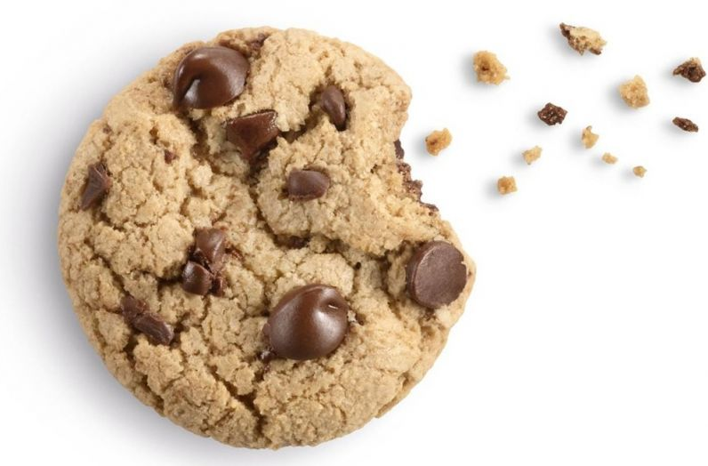
Cookies: State in a Stateless system
HTTP is a stateless system, no memory of prior interactions
Cookies are a way to add state
Remember your username when you log back into a website
Remember what was in your shopping cart
Remember preferences on a site
Remember advertising information
...

Slide 24
Cookies
Four components to cookies
Cookie header line in an HTTP response message
Set-cookie: ….
Cookie header line in an HTTP request message
Cookie: ….
Cookie file stored on the user’s host, managed by browser
Database on the Web server linked to cookie information

Slide 25
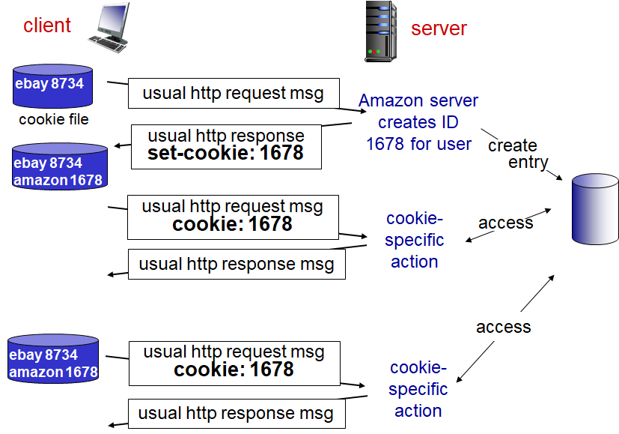

Slide 26
Cookies & Privacy
Cookies can allow websites to gather enormous amounts of data about you
Browsing habits, purchasing habits, info typed into website, … can all be stored in a database and associated with your cookie ID

Slide 27
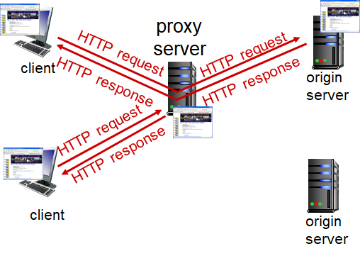
Web Caching
Web caches store previously requested data close to end users’ machines
Goal: be able to satisfy a user’s request without requesting content from the origin server
Browser sends request to cache
Cache checks if it has requested file
Returns it if it does, otherwise sends request to origin server

Slide 28
Web Caching
Both client and server
Serves request from original client
Requests files from origin server
Caches usually installed by ISP (institutional, residential, …)

Slide 29
Why Web Caching?
Reduces response time for clients’ requests
Reduces traffic on institution’s access link
Reduce overall traffic across the Internet as a whole

Slide 30
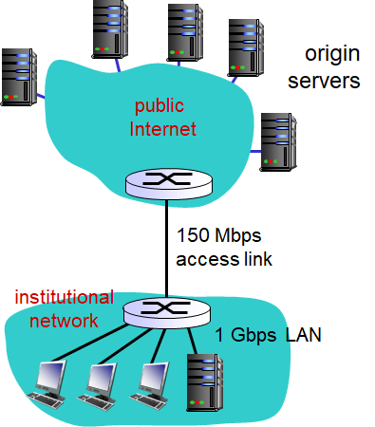
Caching Example
Avg object size: 1 Mb
Avg request rate from all browsers to origin servers: 150/sec
RTT from institution router to any origin server: 2 sec

Slide 31
Caching Example
Avg object size: 1 Mb
Avg request rate from all browsers to origin servers: 150/sec
RTT from institution router to any origin server: 2 sec
What is LAN utilization?

Slide 32
Caching Example
Avg object size: 1 Mb
Avg request rate from all browsers to origin servers: 150/sec
RTT from institution router to any origin server: 2 sec
What is LAN utilization?
(150 requests/sec) * (1 Mb/request)/(1 GBps) = 0.15

Slide 33
Caching Example
Avg object size: 1 Mb
Avg request rate from all browsers to origin servers: 150/sec
RTT from institution router to any origin server: 2 sec
What is Link utilization?
Notes:
(150 requests/sec) * (1 Mb/request)/(150 MBps) = 1.0

Slide 34
Caching Example
Avg object size: 1 Mb
Avg request rate from all browsers to origin servers: 150/sec
RTT from institution router to any origin server: 2 sec
What is Link utilization?
(150 requests/sec) * (1 Mb/request)/(150 Mbps) = 1.0

Slide 35
Caching Example
Avg object size: 1 Mb
Avg request rate from all browsers to origin servers: 150/sec
RTT from institution router to any origin server: 2 sec
LAN utilization = 0.15
Link utilization = 1.0
Total delay = 2 sec + minutes (link) + usecs (LAN)

Slide 36
Simple solution: Upgrade the link
If we increase the link bandwidth to 1 GBps, the problem goes away
(150 requests/sec) * (1 Mb/request) / 1 GBps = 0.15 utilization
Total delay = 2 sec + msec (Link) + usec (LAN)
BUT, much more expensive

Slide 37
Other solution: Add a cache server
Cache servers reduce the need for a high bandwidth link by reducing the number of requests that go out onto the link
Reduce link traffic by cache hit rate (how often the requested data is in the cache)
Typically ranges between 0.2 and 0.7

Slide 38
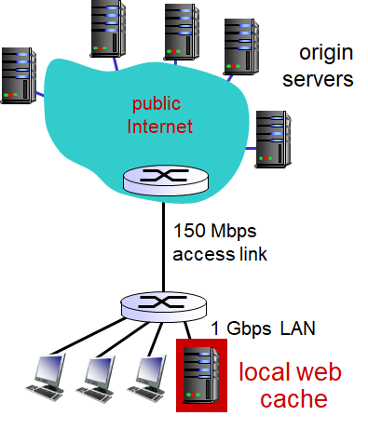
Caching Example
Avg object size: 1 Mb
Avg request rate from all browsers to origin servers: 150/sec
RTT from institution router to any origin server: 2 sec
Also assume cache hit rate is 0.4

Slide 39
Caching Example
Avg object size: 1 Mb
Avg request rate from all browsers to origin servers: 150/sec
RTT from institution router to any origin server: 2 sec
Institution Access link rate: 1000 MBps
Also assume cache hit rate is 0.4
LAN utilization remains the same = .15
Link utilization:
(150 req/sec) * (1 Mb/req)/(150 MBps) * 0.6 = 0.6

Slide 40
Caching Example
Avg object size: 1 Mb
Avg request rate from all browsers to origin servers: 150/sec
RTT from institution router to any origin server: 2 sec
Institution Access link rate: 1000 MBps
Also assume cache hit rate is 0.4
LAN utilization remains the same = .15
Link utilization:
(150 req/sec) * (1 Mb/req)/(150 MBps) * 0.6 = 0.6
Total delay
0.6 * (delay from origin server) + 0.4 * (delay from cache) =
0.6 * (2 sec + msecs) + 0.4 * (usec) ~ 1.2 seconds → faster than 1 Gbps link

Slide 41
Of the options shown below, which best represents the likely delay assuming the following conditions:
3 seconds
Minutes
3 seconds + msecs + usecs
3 seconds + minutes + usecs
Minutes + usecs
Avg object size: 100 kb
Avg request rate from all browsers to origin servers: 100/sec
RTT from institution router to any origin server: 3 sec
Institution Access link rate: 50 Mbps
NO CACHE
Notes:
Compute the utilization rate, determines queuing latency
Total data being moved around = 100kb * 100 = 10000kb = 10 Mb
10 Mb/50Mbps = .2 utilization
Best option is C, because we are going to have minimal queuing latency

Slide 42
Of the options shown below, which best represents the likely delay assuming the following conditions:
3 seconds
Minutes
3 seconds + msecs + usecs
3 seconds + minutes + usecs
Minutes + usecs
Avg object size: 100 kb
Avg request rate from all browsers to origin servers: 495/sec
RTT from institution router to any origin server: 3 sec
Institution Access link rate: 50 Mbps
NO CACHE
Notes:
Compute the utilization rate, determines queuing latency
Total data being moved around = 100kb * 495= 49500kb = 49.5 Mb
49.5 Mb/50Mbps = .99 utilization
Best option is D, because we are going to have a lot of queuing latency due to high utilization

Slide 43
Of the options shown below, which average delay is most likely to be observed assuming the following conditions:
3 seconds
3.03 seconds
1.5 seconds
2.15 seconds
183 seconds
Avg object size: 200 kb
Avg request rate from all browsers to origin servers: 200/sec
RTT from institution router to any origin server: 3 sec
Institution Access link rate: 50 Mbps
Cache, 30% hit rate
Notes:
Compute the utilization rate, determines queuing latency
Total data being moved around = 200kb * 200= 40000kb = 40 Mb
40 Mb/50Mbps = .8 utilization
Now factor in cache to utilization = .8 * (1-.3) = 0.56
(1 - .3) → the amount of traffic NOT served by the cache, that has to go out over the access link
Now compute latency
Total Latency = latency for traffic to the Internet + latency for traffic to the cache →
(3 sec + msec + usec) * .7 + (usec)*.3
→ best option is 2.15 seconds (D)

Slide 44
Of the options shown below, which average delay is most likely to be observed assuming the following conditions:
3 seconds
3.03 seconds
1.5 seconds
2.15 seconds
183 seconds
Avg object size: 200 kb
Avg request rate from all browsers to origin servers: 500/sec
RTT from institution router to any origin server: 3 sec
Institution Access link rate: 50 Mbps
Cache, 50% hit rate
Notes:
Compute the utilization rate, determines queuing latency
Total data being moved around = 200kb * 500= 100000kb = 100 Mb
100 Mb/50Mbps = .2 utilization
Now factor in cache to utilization = .2 * (1-.5) = 1.0
(1 - .5) → the amount of traffic NOT served by the cache, that has to go out over the access link
Now compute latency
Total Latency = latency for traffic to the Internet + latency for traffic to the cache →
(3 sec + minutes + usec) * .5 + (usec)*.5
→ best option is 183 seconds (D)

Slide 45
Conditional GET
One more step needed to make the cache work
What do we do if the cache has a copy, but it’s old?
Cache can grow stale
The cache’s copy of a file was received before a certain time
E.g. 1 week ago
If the file is stale, cache checks to see if there is an updated version at the origin server, issues a Conditional GET

Slide 46
Conditional GET
Conditional GET includes header value If-Modified-Since
Server checks to see if it has a new file
If it does, return the file, response 200 OK
Else, response 304 Not Modified
Requires a RTT, but minimizes data transmission
GET /index.html HTTP/1.1\r\n
…
If-Modified-Since: <data>
...
\r\n

Slide 47

Conditional GET
Cache receives request
No
Have object?
Is it stale?
Request from origin server with If-Modified-Since
304 Not Modified
Yes
Yes
No
200 OK
Request from origin server
Save to Cache
Return to client

Slide 48
Before Next Class
Start working on Programming Assignment 1: Introduction to Python
Due 9/12 at midnight

Slide 49
Persistent vs. Non-Persistent HTTP
Two types of HTTP connections:
Persistent connections downloads multiple objects over the same TCP connection
Non-persistent connections use a new TCP connection for each object that needs to be downloaded
Important distinction as most HTTP requests will require multiple objects to be downloaded (HTML, images, etc)
HTTP defaults to persistent connections

Slide 50
Non-Persistent Connections
Imagine requesting 1 HTML file containing 10 images
Server
Listens for request on port 80
Create new socket
Send HTTP response containing requested html page
Close client socket
Client
Initiates TCP connection to HTTP server
Send HTTP request message into socket requesting specific page
Receives response, parses for other objects, initiates new requests

Slide 51
Non-Persistent HTTP Response Time
RTT = time for a packet to travel to the server and back
HTTP response time
1 RTT to initiate TCP connection
1/2 RTT to send HTTP request
File transmission time
½ RTT to receive HTTP
Total = 2 RTT + file transmission time

Slide 52
Problems with Non-Persistent HTTP
Requires two RTTs per object
Has OS overhead for each TCP connection
Increased overhead for client and server
Browsers often open parallel TCP connections to fetch the referenced objects, resulting in more overhead

Slide 53
Persistent HTTP
Persistent HTTP leaves the TCP connection open after the first request, continues to use it for new requests
Only one RTT for subsequent objects
Less overhead on client and server
Pipelining the requests allows the responses to be rapidly delivered in sequence

Slide 54
Compute how long it will take to download a web page of the following description using a non-persistent connection. Report results in seconds
1 web page (100 Kb), includes 10 images (1 Mb each)
2 seconds to travel to server and back (RTT)
NO parallel connections
1 Mbps symmetric link connects client and server
Assume transmission time for packets from client is negligible
Notes:
Total d_trans = 10.1 Mb/1Mbps = 10.1 seconds
11 connections to server needed, in serial = 11 * 2RTT = 44 seconds
Total = 54.1 seconds

Slide 55
Compute how long it will take to download a web page of the following description using a non-persistent connection. Report results in seconds
1 web page (100 Kb), includes 10 images (1 Mb each)
2 seconds to travel to server and back (RTT)
5 parallel connections
1 Mbps symmetric link connects client and server
Assume transmission time for packets from client is negligible
Notes:
Total d_trans = 10.1 Mb/1Mbps = 10.1 seconds
11 connections to server needed,
1 to get the web page
5 in parallel to get 5 images
5 in parallel to get 5 images
= 3 * 2RTT = 12 seconds
Total = 22.1 seconds

Slide 56
Compute how long it will take to download a web page of the following description using a persistent connection. Report results in seconds
1 web page (100 Kb), includes 10 images (1 Mb each)
2 seconds to travel to server and back (RTT)
1 Mbps symmetric link connects client and server
Assume transmission time for packets from client is negligible
Notes:
Total d_trans = 10.1 Mb/1Mbps = 10.1 seconds
1 RTT to establish connection
1 RTT to request webpage
1 RTT to request 10 images
= 10.1 + 6 = 16.1 seconds

